Slide 1

Brewski
“Let no man thirst for good beer.” –Sam Adams

Slide 2
Table of content
01
02
03
04
Context
About Brewski
The US Craft Beer Market
Our Vision

Slide 3
01
Context

Slide 4
Context
Who are we?
The Data Analytics Team representing Brewski.
Our Audience:
Company’s partners, shareholders, and potential investors.
Our Motive:
To present our company’s growth to gain more investors.

Slide 5
02
About Brewski

Slide 6
Brewski
5 Million barrels per year on average in the last 4 years…

Slide 7
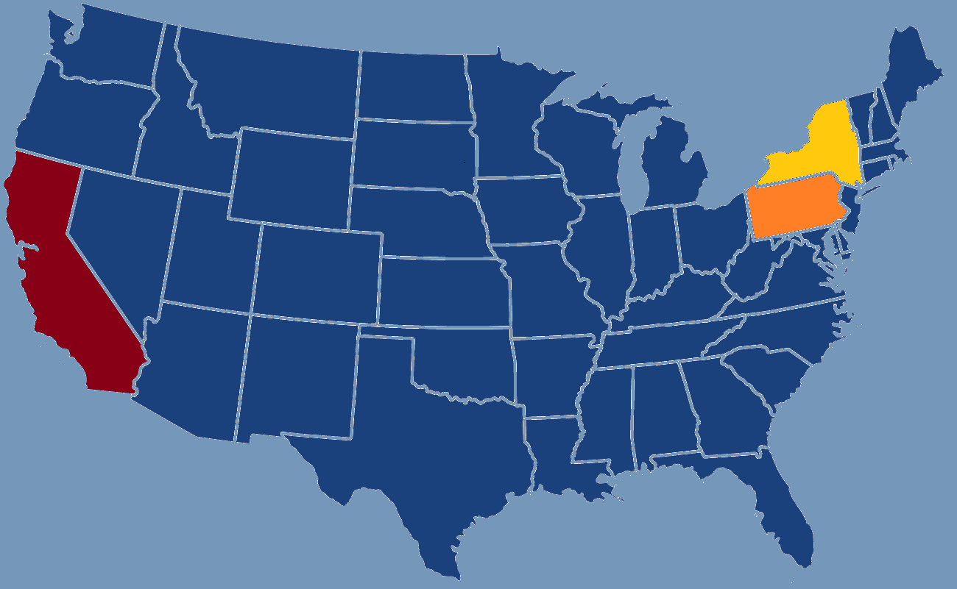
Biggest Consumer States
California
3356134 barrels in 2020
Pennsylvania
3156073 barrels in 2020
New York
1257395 barrels in 2020

Slide 8

About Brewski
Customer Base
Craft Beer
More than 240 Million in the United States.
10% increase in Craft Beer in the past 23 years

Slide 9
8,884
Total breweries in the United States.

Slide 10
Be-er yourself

Slide 11
03
The Craft Beer Market

Slide 12
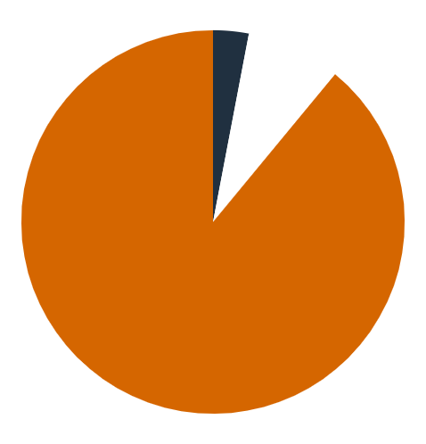
Beer category percentage 1998
2.63%
Craft Beer
8.41%
Import Beer
88.96%
US Non-Craft Beer

Slide 13
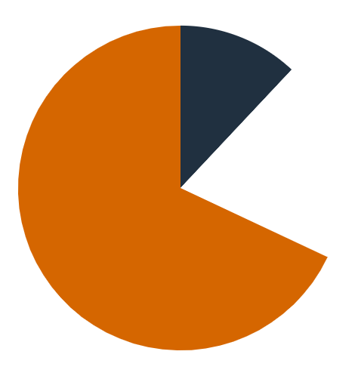

Beer category percentage 2020
12.3%
Craft Beer
19.5%
Import Beer
68.2%
US Non-Craft Beer

Slide 14
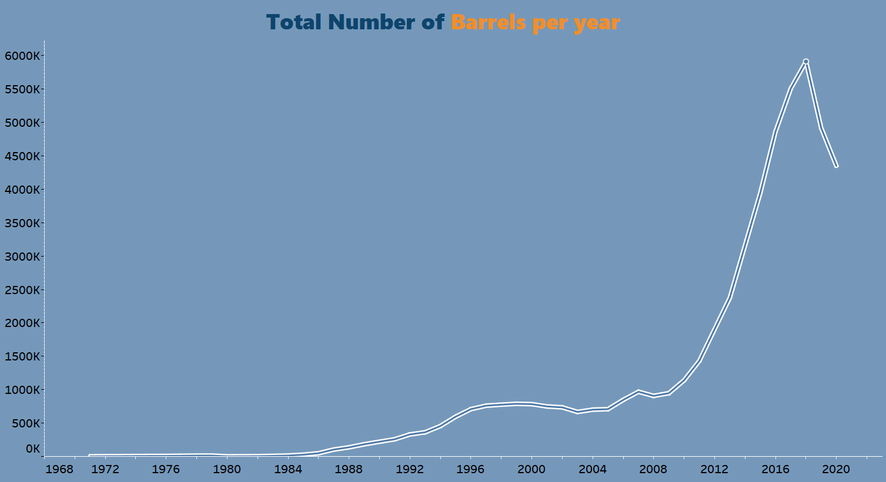

59,13,143 barrels in 2018

Slide 15
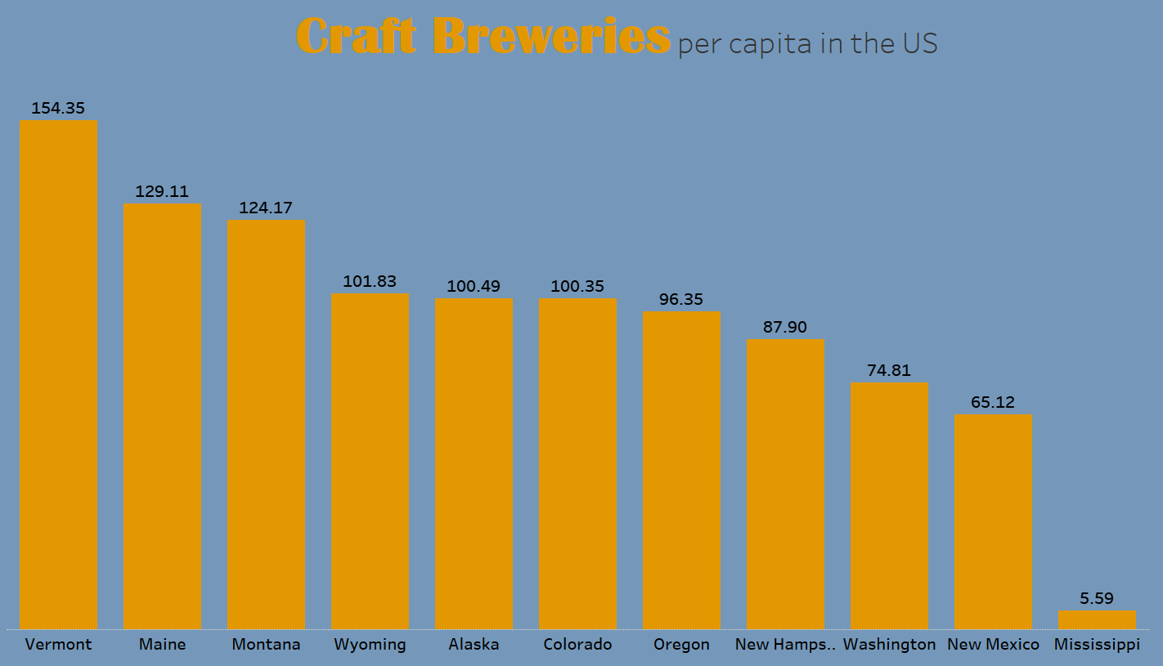
(×10⁻⁶⁾

Slide 16
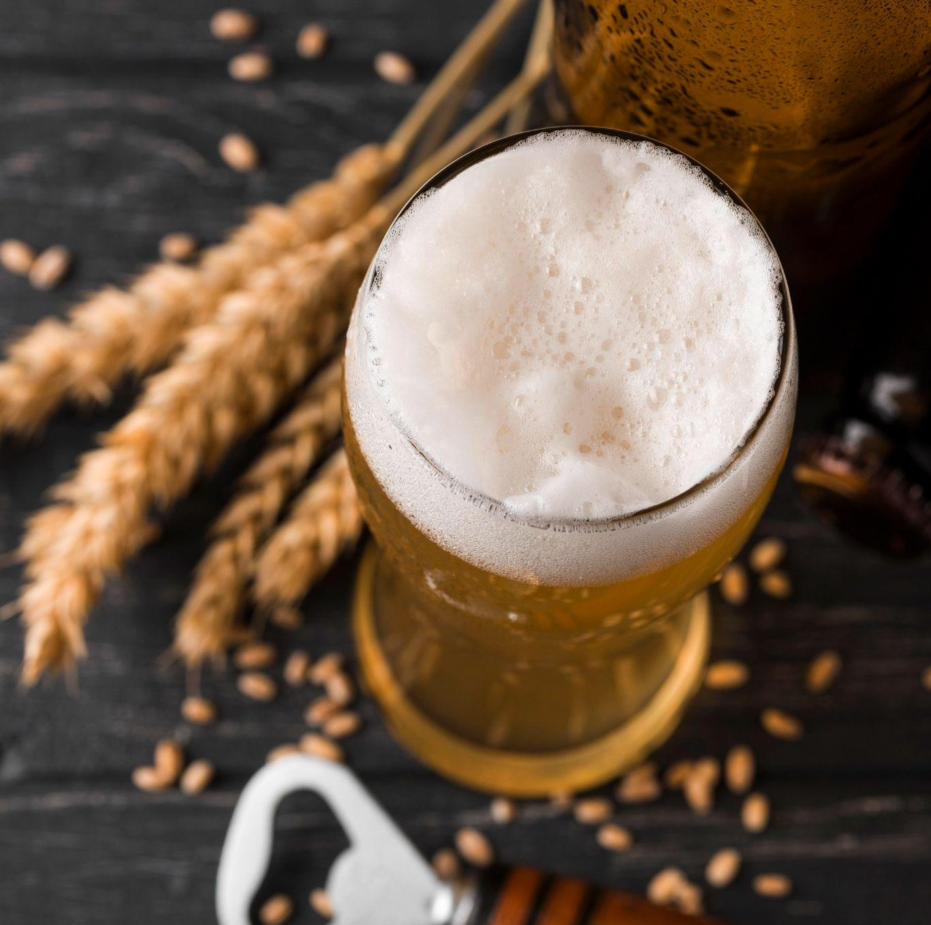
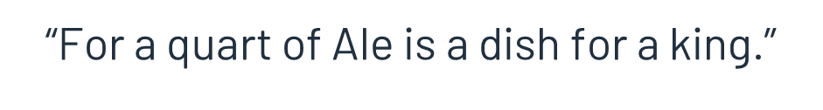


Slide 17
04
Our Vision

Slide 18
To conclude, we plan on…
Increased production of Craft Beer
More type of beers
More barrel holding capacity
More breweries in the States
Increased Breweries per capita

Slide 19
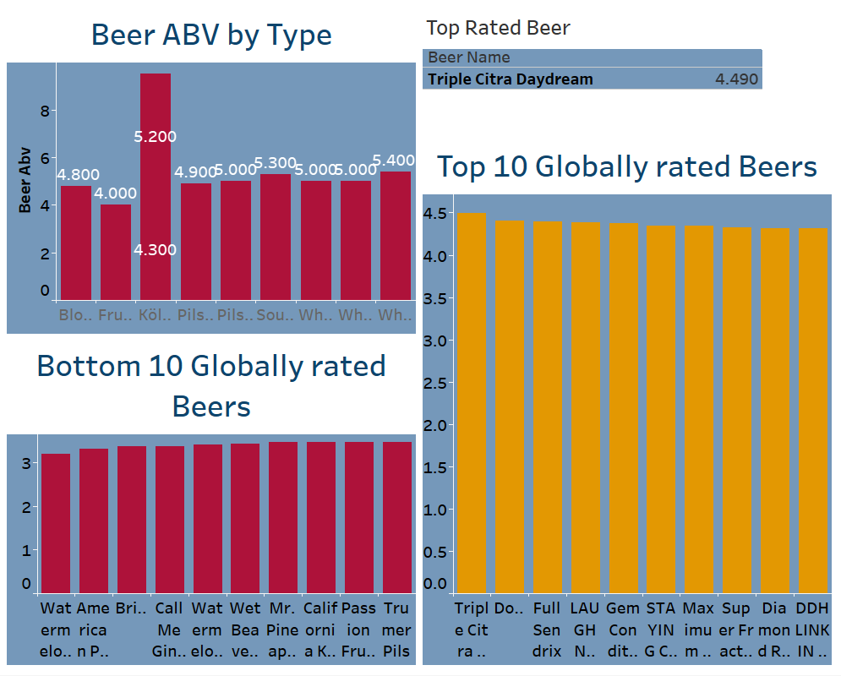
Here’s a dashboard to access data from the Consumer Behavior sheet at once…
(Will need highlighters on the live dashboard to check individual graphs)

Slide 20
Thanks!

Slide 21
References
https://en.wikipedia.org/wiki/Beer
https://vinepair.com/beer-101/
https://www.britannica.com/topic/beer
https://www.craftbeer.com/beer/beer-styles-guide
https://slidesgo.com/
https://www.flaticon.com/

